Slide 1
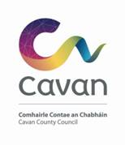

Cavan PEACEPLUS Action Plan
Consultation Analysis

Slide 2
Survey
Focus Groups
200 replies
122 participants
Councillors
Public meetings
45 participants
12 participants

Slide 3
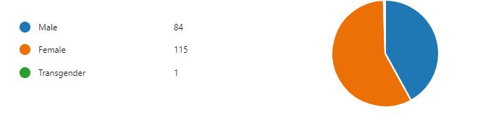
1. Gender

Slide 4
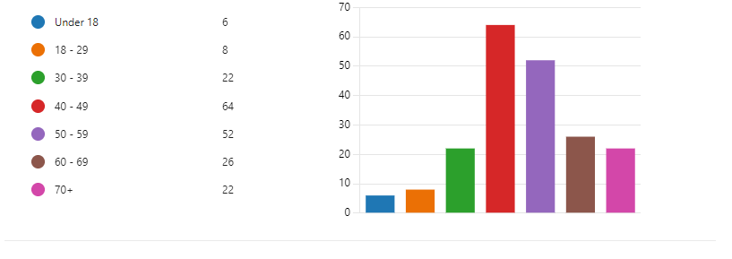
Age

Slide 5
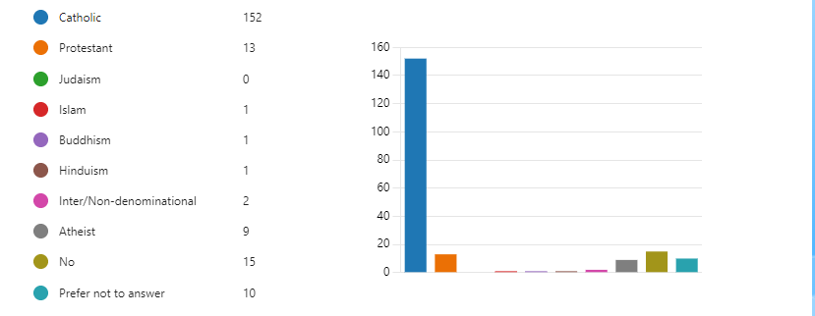
Religion or belief

Slide 6
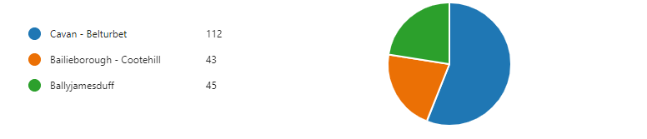
Municipal District

Slide 7
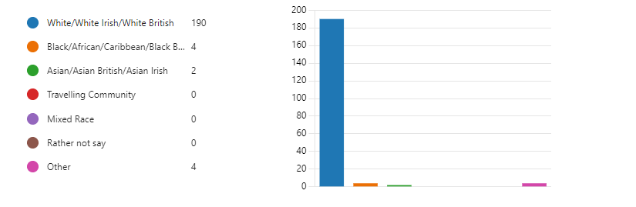
Ethnic Background

Slide 8
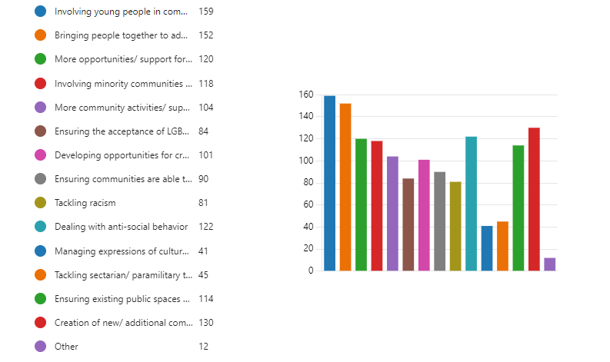
Most important priorities for building peaceful and thriving communities
Top 6 answers:
Involving young people in community activities and building new friendships with others
Bringing people together to address common issues i.e. Mental health, unemployment, environmental programmes etc
Creation of new/additional community spaces which are open to all
Dealing with Anti-social behaviour
More opportunities/support for community activities engaging older people
Involving minority communities in community life and activities

Slide 9
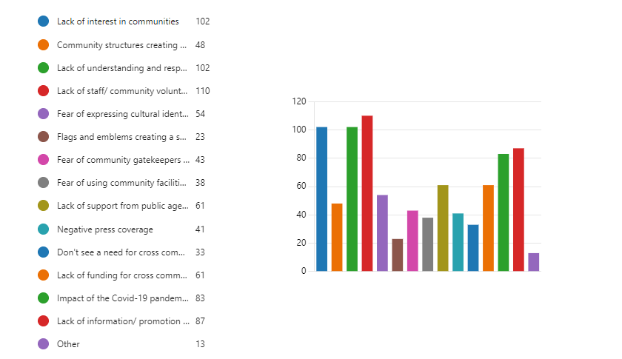
Biggest barriers to community integration and cohesion
Top 5 answers:
1. Lack of staff/community volunteers to undertake community activities
2. Lack of interest in communities
2. Lack of understanding and respect for others of different cultural backgrounds, religious/political belief, ability or sexual orientation
4. Lack of information/promotion of cross community activities and events
5. Impact of COVID-19 pandemic increasing isolation/preventing people from becoming engaged in community activity

Slide 10

Order of priority

Slide 11
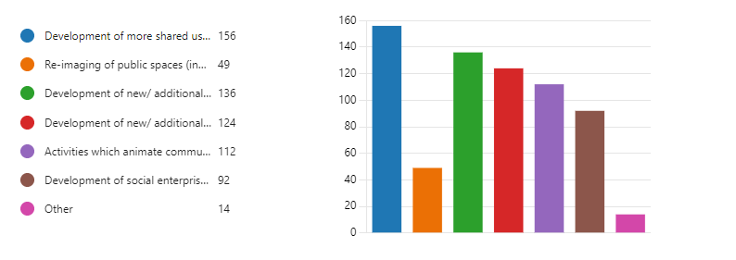
Activities/ actions should be included in the Action Plan for local community regeneration and transformation
Top 5 answers:
Development of more shared use of existing community spaces
Development of new/additional indoor community spaces to increase cross community interaction
Development of new/additional outdoor community spaces to increase cross community interaction
Activities which aminate community facilities and encourage wider access and participation
Development of social enterprise spaces
Top 5 answers:
Development of more shared use of existing community spaces
Development of new/additional indoor community spaces to increase cross community interaction
Development of new/additional outdoor community spaces to increase cross community interaction
Activities which aminate community facilities and encourage wider access and participation
Development of social enterprise spaces

Slide 12
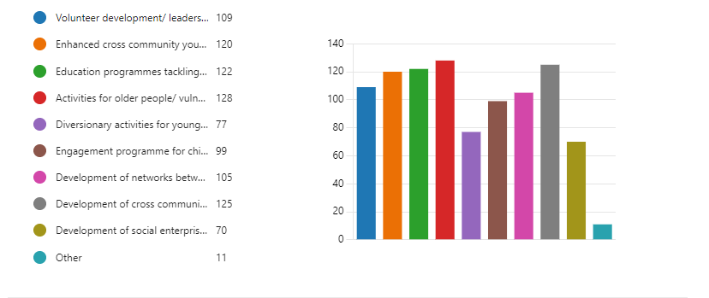
Top 5 answers:
Activities for older people/vulnerable residents
Development of cross community activities of common interest i.e. health and well being activities, arts activities, sports activities, family activities etc
Education programmes tackling issues related to self-esteem, bullying, cyber safety and appropriate use of social media
Enhanced cross community youth activities i.e. through youth centres, drop in programmes, sport/arts/cultural activities
Volunteer development/leadership programmes
Activities/ projects should be included in the Action Plan to build/ sustain thriving and peaceful communities

Slide 13
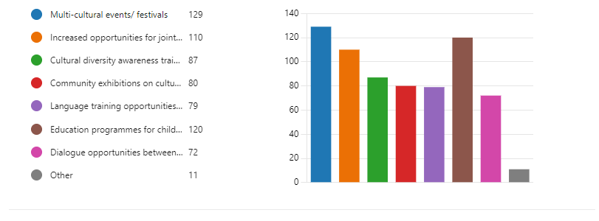
Top 6 answers:
Multi-cultural events/festivals
Education programmes for children on cultural traditions within our community
Increased opportunities for joint activities between community organisations of different cultural backgrounds
Cultural diversity awareness training
Community exhibitions on culture and heritage
Language training opportunities inc; Irish language, Ulster Scots and English language courses for those who don’t have English as a first language
Activities/ actions should be included in the Action Plan to ensure understanding and celebration of culture and heritage in our community

Slide 14
Public meetings & focus groups
Location | Date | Time | Participants
Cavan Town | 16th February | Morning | 6
Cavan Town | 16th February | Evening | 6
Cavan Town | 16th February | Afternoon | 12 -Councillors
Ballyjamesduff | 20th February | Evening | 15
Cavan Town | 22nd February | Morning | 10 - 4c’s MC group
Cavan Town | 22nd February | Afternoon | 32 – CCC staff
Cavan Town | 22nd February | Afternoon | 13 – Older peoples council
Cavan Town | 22nd February | Afternoon | 23 - Stakeholders
Cavan Town | 22nd February | Afternoon | 5 – Comhairle na nOg
Cootehill | 22nd February | Evening | 18

Slide 15
Public meetings & focus groups completed
Location | Date | Time | Participants
Telephone conversation | 9th March | Morning | 1 – Local link
Telephone conversation | 9th March | Afternoon | 1 – Citizens information
Telephone conversation | 10th March | Afternoon | 1 – Teach Oscail
Zoom | 13th March | Morning | 9 - LDC
Teams | 14th March | Morning | 6 - Disability network
Zoom | 14th March | Afternoon | 7 - Traveller Focus group
Cavan Town | 24th March | Morning | 17 - Economic element (LECP)

Slide 16
Theme 1 –Community Regeneration & Transformation
Top 5 answers:
Development of more shared use of existing community spaces
Development of new/additional indoor community spaces to increase cross community interaction
Development of new/additional outdoor community spaces to increase cross community interaction
Activities which aminate community facilities and encourage wider access and participation
Development of social enterprise spaces
Project ideas:
Capital Improvement Programme to upgrade existing community spaces bringing them to a higher standard and increasing cross-community interaction.
An Outdoor Recreational Capital Programme to enhance existing spaces as a welcome space for all communities.
Capital Programme to enhance Youth facilities/outdoor space in town’s with no youth facility e.g. smart youth shelters.
A community focused Shared Spaces Animation Programme to enhance/transform Council / community owned unused green space e.g., community gardens, picnic/seating areas, art features etc.

Slide 17
Theme 2 –Thriving and peaceful communities
Project ideas:
Historical focused programme focusing on topics of common/shared interests & legacy issues e.g. history of our local villages & towns, railways, waterways, famine etc.
A county-wide ‘Health and Well-Being Initiative’.
A co-designed Local Cross-Community Activity Plan to complement each of the Capital Programmes and bring youth groups together in joint activity.
Youth Programme e.g. sports, drama, arts, summer schemes that include tackling issues related to self-esteem, bullying, cyber safety and appropriate use of social media
Volunteer Capacity Building and Training Programme with emphasis on recruiting young volunteers, leadership training & networking / partnership working.
Top 5 answers:
Activities for older people/vulnerable residents
Development of cross community activities of common interest i.e. health and well being activities, arts activities, sports activities, family activities etc
Education programmes tackling issues related to self-esteem, bullying, cyber safety and appropriate use of social media
Enhanced cross community youth activities i.e. through youth centres, drop in programmes, sport/arts/cultural activities
Volunteer development/leadership programmes

Slide 18
Theme 3 –Building respect for all cultural traditions
Top 6 answers:
Multi-cultural events/festivals
Education programmes for children on cultural traditions within our community
Increased opportunities for joint activities between community organisations of different cultural backgrounds
Cultural diversity awareness training
Community exhibitions on culture and heritage
Language training opportunities inc; Irish language, Ulster Scots and English language courses for those who don’t have English as a first language
Project ideas:
Celebration of Arts, Music, Heritage, Culture focused Programmes through delivery of workshops, festivals, exhibitions, publications, events etc.
Programmes to integrate Newcomer communities into our local communities and for our communities in turn to learn more about their own and other cultures.
English Support Programmes (in a non-formal setting) for Newcomer communities

Slide 19
Discussion:
Thoughts?
Identify gaps
Stage 2 consultations

